Slide 1
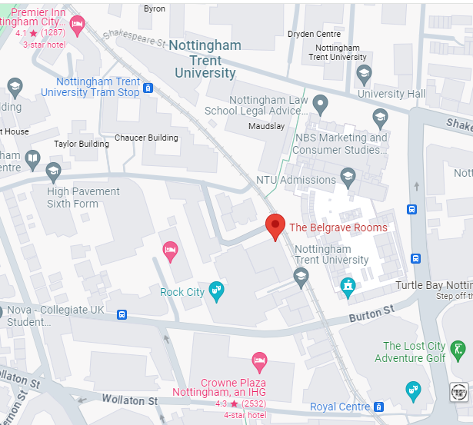
Nottingham Tram info
Ticket type | Single | All Day
Adult | £3.30 | £5.40
Student | £2.70 | £4.40
Under 22 | £2.70 | £4.40
UK concessionary pass holder |  | £3.80
Short hop* | £1.50
The Belgrave Rooms sits between two tram stops:
Nottingham Trent University
Royal Centre
*Short hop ticket available between Station Street (Nottingham Train Station) and Nottingham Trent University stops
Tram stop
Tram stop

Slide 2
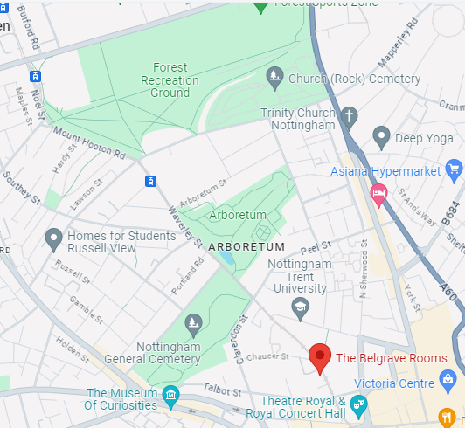
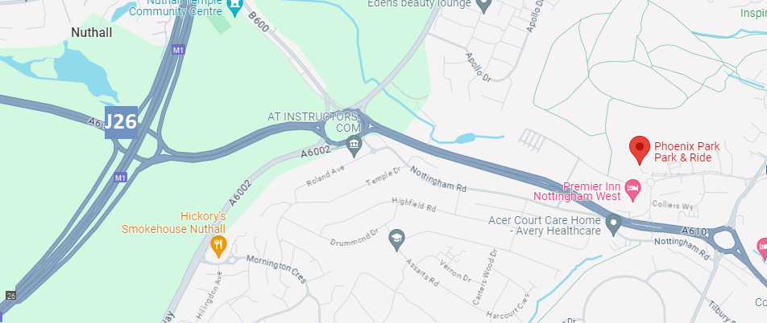
Park and Ride locations for tram
The Forest (NG7 6AQ): 2 stops / 5 minutes away from Nottingham Trent University stop
Tram stop
Phoenix Park (NG8 6AS): Just off J26 of the M1
10 stops / 20 minutes away from Nottingham Trent University stop
Tram stop

Slide 3
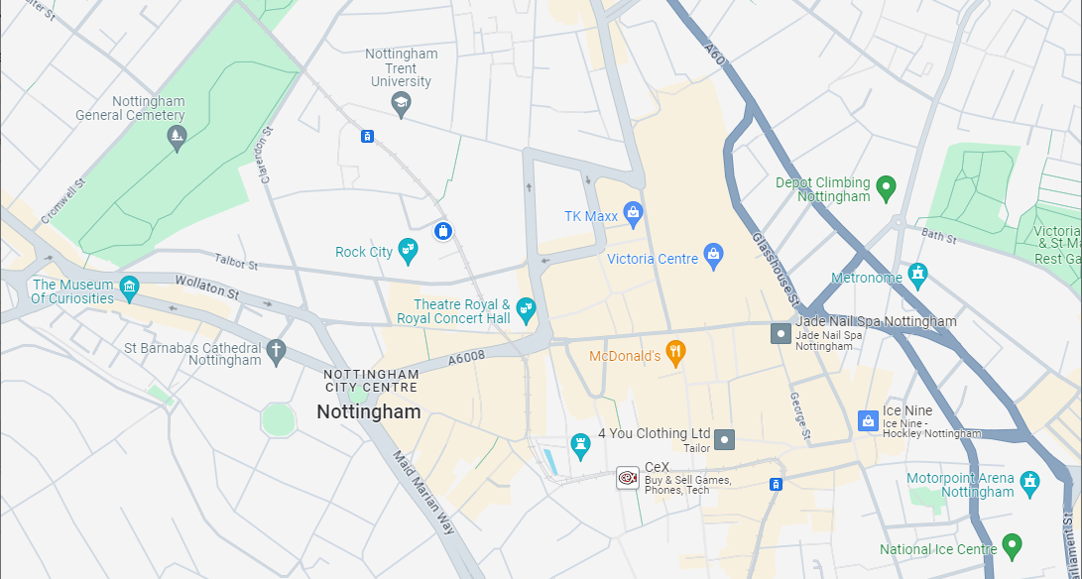
Car Park Info
Talbot Street Cark Park – Q-Park
2 minutes walk to The Belgrave Rooms
£19 up to 9 hours / £20 up to 24 hours
Nottingham Central Cark Park – Q-Park
2 minutes walk to The Belgrave Rooms
£19 up to 9 hours / £20 up to 24 hours
Upper Parliament Street Cark Park – Euro Car Parks
5 minutes walk to The Belgrave Rooms
£14 up to 12 hours
Pre-booking available
Trinity Square Car Park – Nottingham City Council
5 minutes walk to The Belgrave Rooms
£18 up to 24 hours
£8 Early bird parking, park and pay before 9:30, leave before 18:30
Victoria Centre Cark Park
10 minutes walk to The Belgrave Rooms
£16.50 for 7-24 hours
The Belgrave Rooms

